Slide 1
MATLAB for Scientists Lecture 8: Image Analysis I

Slide 2
Overview of images in MATLAB
Working with images
Image indexing
Basic image manipulation

Slide 3
Applications of image processing
BIOLOGICAL: automated systems analysis of samples
DEFENSE/INTELLIGENCE: enhancement and interpretation of image to find and track targets
DOCUMENT PROCESSING: scanning, archiving
FACTORY AUTOMATION: visual inspection of products
MATERIALS TESTING: detection and quantification of cracks, impurities, etc.
MEDICAL: disease detection and monitoring

Slide 4
Image input/output + conversions
Importing (reading) + visualizing images
imread | Read in image
imshow | Display image in figure
Converting between image types
im2bw or imbinarize | Image to binary
im2double | Image to double precision
uint8 | Unsigned 8-bit integer
rgb2gray | RGB image to grayscale

Slide 5
Images in MATLAB
Picture formats supported by MATLAB
Data types in MATLAB
BMP | Microsoft windows bitmap
GIF | Graphics interchange files
HCF | Hierarchical Data Format
JPEG | Joint Photographic Experts Group
PCX | Paintbrush
PNG | Portable Network Graphics
TIFF | Tagged Image File
XWD | X Window Dump
double | 64-bit double-precision floating point
single | 32-bit single-precision floating point
int32 | 32-bit signed integer
int16 | 16-bit signed integer
int8 | 8-bit signed integer
uint32 | 32-bit unsigned integer
uint16 | 16-bit unsigned integer
uint8 | 8-bit unsigned integer
Can convert between types since these are functions!

Slide 6
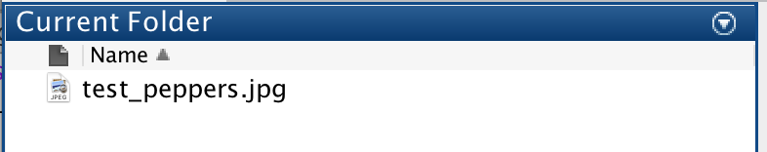
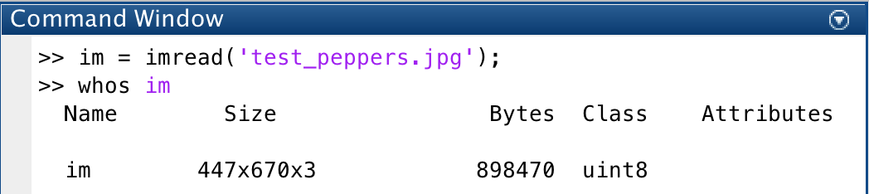
How to read an image:
Image in current directory:
Read in image using imread:

Slide 7
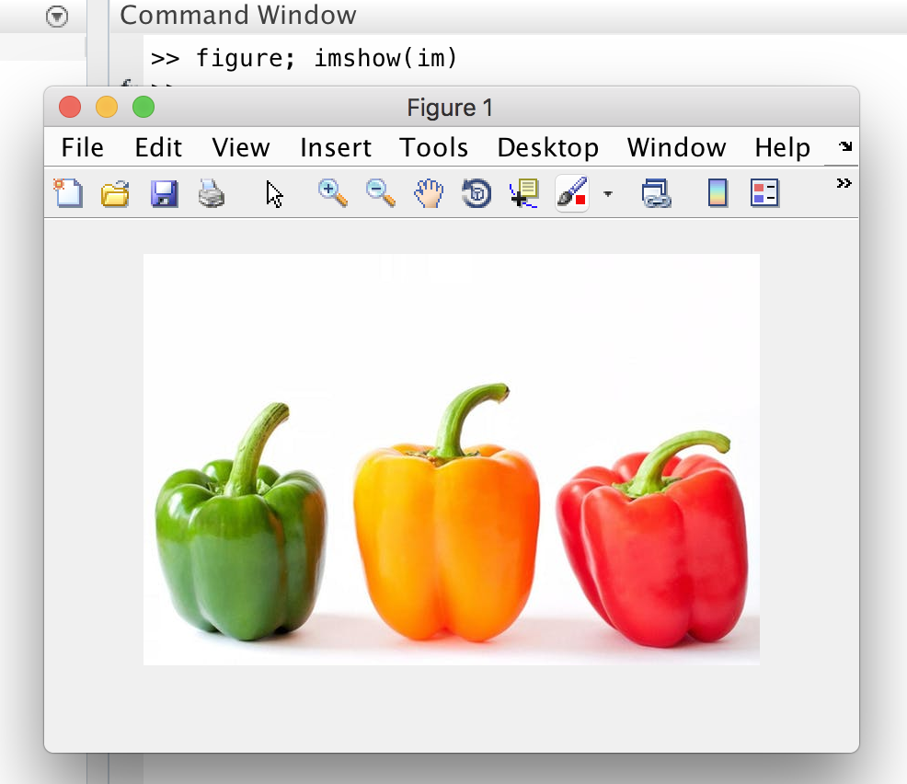
How to visualize an image
figure;
imshow(im)

Slide 8
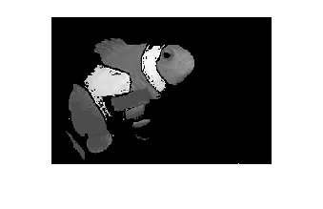
Images in MATLAB
Three types of images:
True color (RGB) image:
Intensity (grayscale) image
Binary image: 0 or 1
MATLAB stores images as arrays (i.e., matrices), in which each element of the matrix corresponds to a single pixel in the displayed image.
RGB
Intensity image
Binary

Slide 9
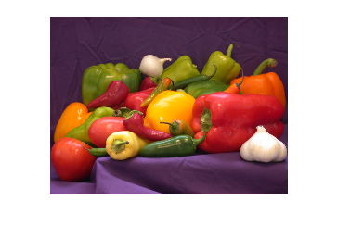
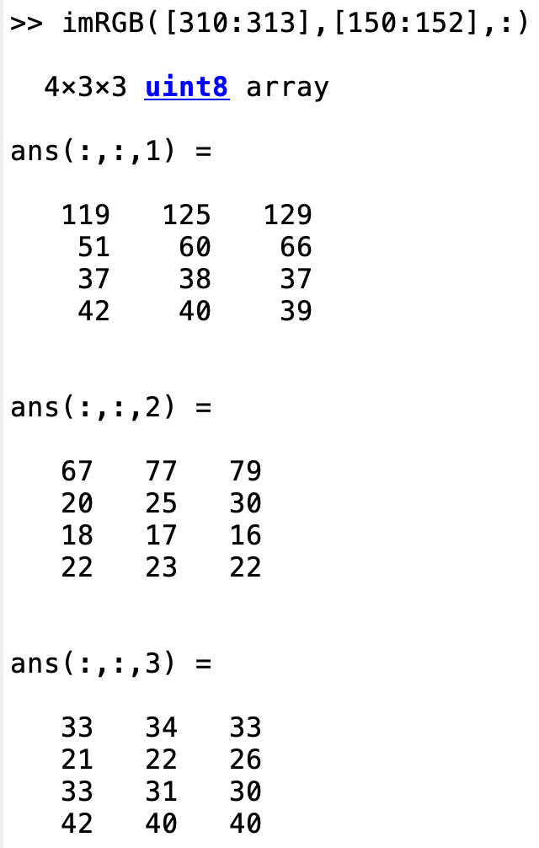
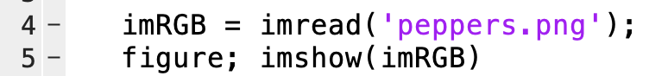
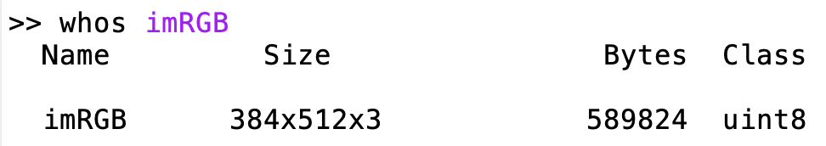
RGB images
All colors can be made out of combinations of red, green, & blue
Computers create color images by layering 3 matrices on top of one another. This 3-layer matrix makes up an RGB image:
Layer 1 = red (R)
Layer 2 = green (G)
Layer 3 = blue (B).
Color images automatically get imported as RGB of size nxmx3
R, G, and B typically take values between [0-255]
Make sure your RGB images are of the uint8 class (otherwise, convert with functions on prev slides)
Three dimensions! Dim = 3

Slide 10
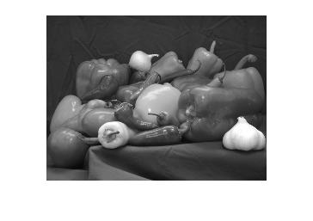
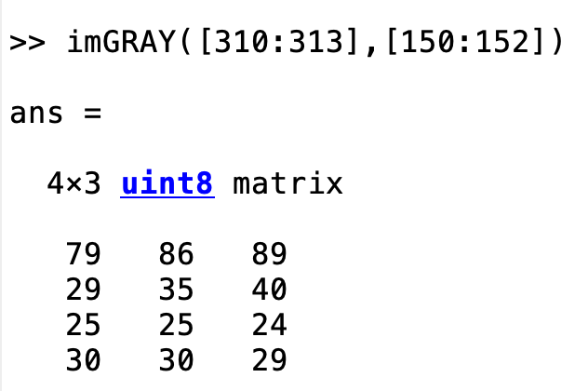
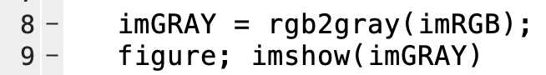
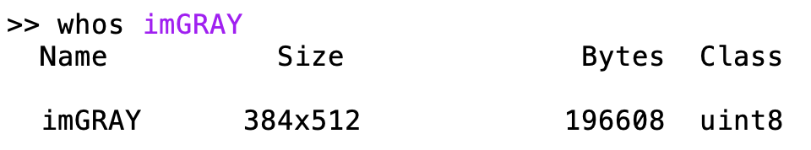
Intensity (grayscale) images: rgb2gray
Every grayscale image is an nxm matrix
Use rgb2gray to convert from RGB to grayscale
3rd dimension disappears! Now, only nxm size
Values range from 0 to 255
If the image is already gray when you import it, it is automatically in grayscale

Slide 11
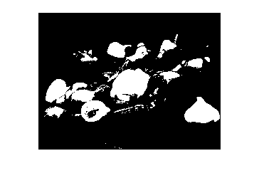
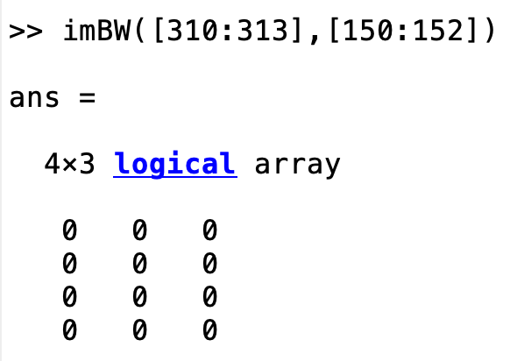
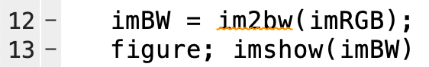
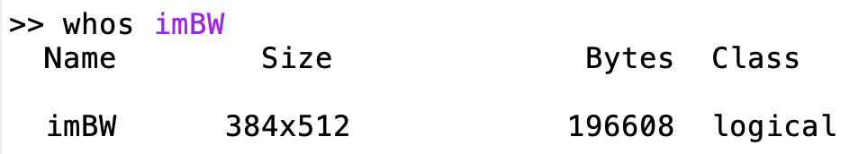
Binary images: im2bw
Use im2bw to convert between RGB or grayscale into a binary image
Size is still only 2-dimensional (nxm), but the class is logical
Logical class! Takes 0 or 1 values only:
1 = white
0 = black

Slide 12
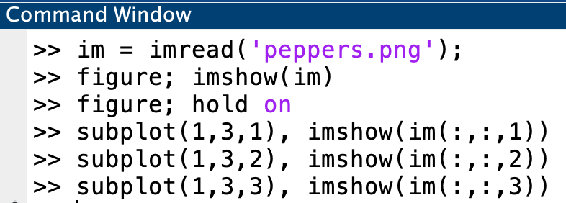
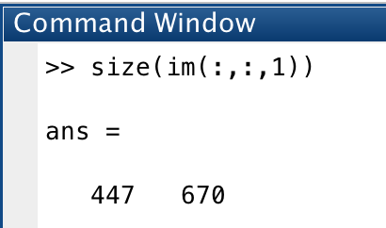
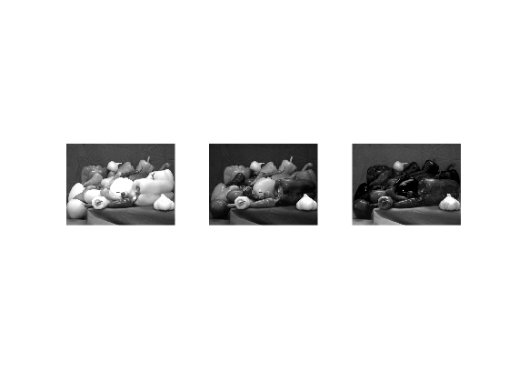
Visualizing R, G, and B individually
If im is RGB, why is this gray?
Red
Green
Blue

Slide 13
Group example 1: practice visualizing and converting images
Import lec8_GrpEx1_peppers.jpg and define an RGB, grayscale, and binary version of it. Plot all three on a 1x3 subplot

Slide 14
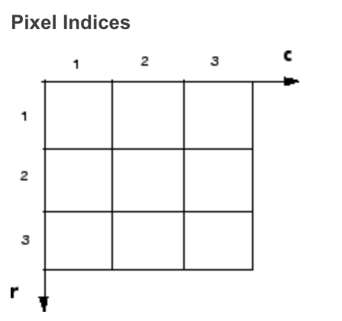
Image coordinates for pixel indexing
Pixel indices: Because images are arrays, you can use standard MATLAB indexing
What’s the index of the red pixel?

Slide 15
How do I access pixels of RGB images?
If we wanted to check the red, green, or blue color of a single pixel in an RGB image called im, we can access each layer individually by specifying the 3rd dimension:
pixR = im(row,col,1) → Red color
pixG = im(row,col,2) → Green color
pixB = im(row,col,3) → Blue color

Slide 16
Modifying pixels in an image: same as any matrix!
im(row,col,1) = red_pix (a value between 0 and 255)
im(row,col,2) = green_pix (a value between 0 and 255)
im(row,col,3) = blue_pix (a value between 0 and 255)
Alternatively:
im(row,col,:) = vec (a 3x1 vector with values between 0 and 255)

Slide 17
Accessing and modifying grayscale and binary pixels
1. Accessing
Grayscale: pix = im(row,col) → gray intensity
Binary: pix = im(row,col) → black (0) or white (1)
2. Modifying
Grayscale: im(row,col) = pix (an intensity value between 0-255)
Binary: im(row,col) = pix (logical value 0 or 1)

Slide 18
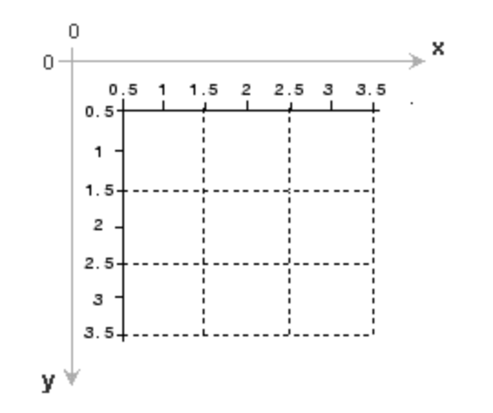
Overlaying plotting functions on an image
To combine images and plotting functions on the same figure, must use hold on after imshow
To plot on an image, think of the rows as y coordinates and columns as x coordinates

Slide 19
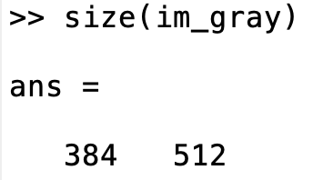
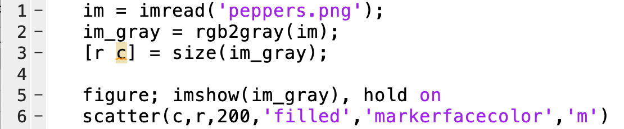
Image coordinates
Place a pink marker on the image at the bottom right corner:
Find the size of the image (r=384 and c=512)
Place a scatter point where x is the cols and r is the rows

Slide 20
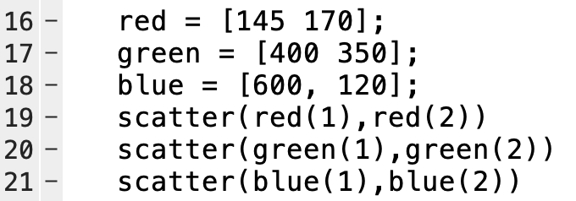
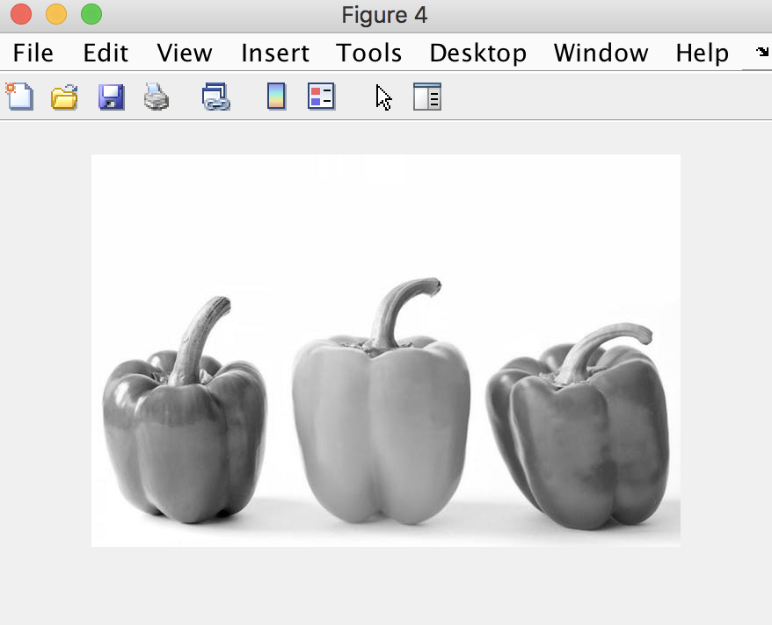
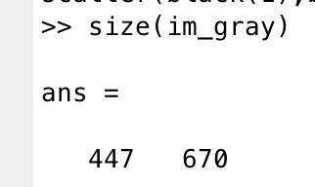
Image coordinates
Which color marker is going to show up on the tip of the left pepper?

Slide 21
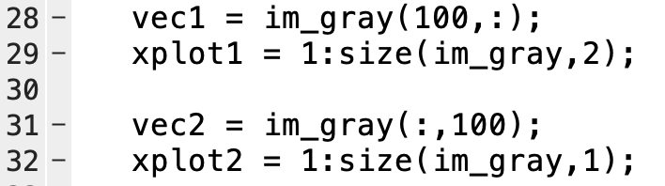
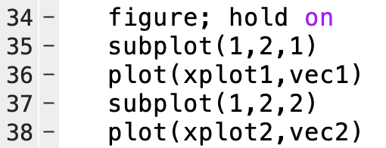
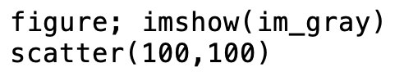
Pulling out vectors from an image
The black marker is at location r=100,c=100 on image im_gray. Write the vector of im_gray that crosses vertically through the pepper.

Slide 22
Download lec8_liveEx2_barnard.jpg and generate a 1x3 subplot, where each plot consists of:
Original image
The subset of the image corresponding to the top left quarter
Original image with a vertical and horizontal line in red that passes through center of the image
Group example 2: practice with image coordinates
Original
Top left corner
Lines through center

Slide 23
Image modification
imadd | Add two images
imsubtract | Subtract two images
immultiply | Multiple two images
imrotate | Rotate an image
imcomplement | Take the complement of an image
imresize | Resizing an image
imhist | Histogram of image data
imadjust | Contrast-adjusts intensity values
adapthisteq | Contrast-limited adaptive histogram equalization (local)
histeq | Enhance contrast using histogram equalization (global)
cumsum | Cummulative summation

Slide 24
imresize
scale takes each of the dimensions of the image (# rows and columns) and multiplies by this much to determine the output
E.g., if we have an image that is 20 rows x 40 columns
scale = 2 → output = 40 rows x 80 columns
scale = 0.5 → output = 10 rows x 20 columns
Can also use [row_scale, col_scale] for scaling each individually
out = imresize(im,scale)

Slide 25
Adding images
Z = imadd(X,Y)
Adds each element in array. With the corresponding element in array Y and returns the sum in the corresponding element of the output array Z

Slide 26
Subtracting images
Z = imsubtract(X,Y)
Subtracts each element in array. With the corresponding element in array Y and returns the sum in the corresponding element of the output array Z

Slide 27
Multiplying images
Z = immultiply(X,Y)
Multiplies each element in array with the corresponding element in array Y and returns the sum in the corresponding element of the output array Z

Slide 28
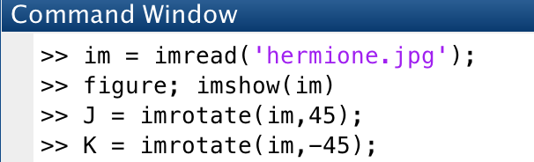
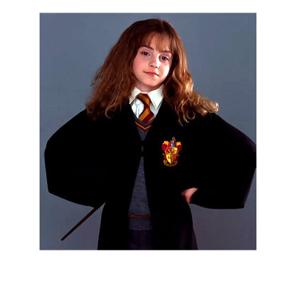
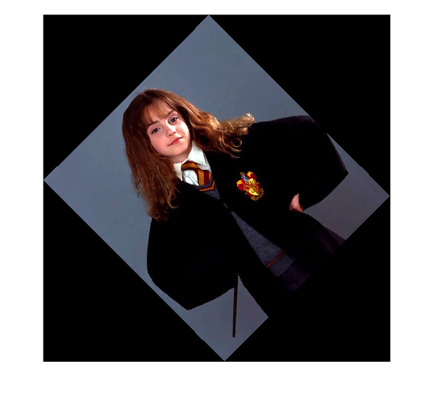
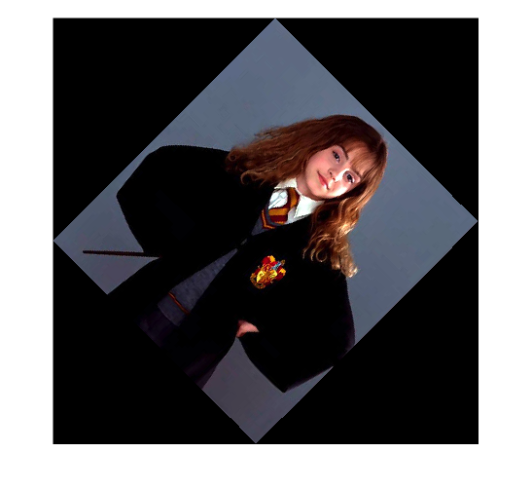
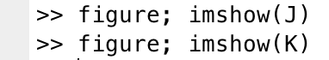
Rotating images

Slide 29
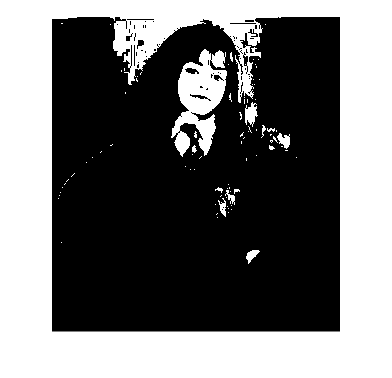
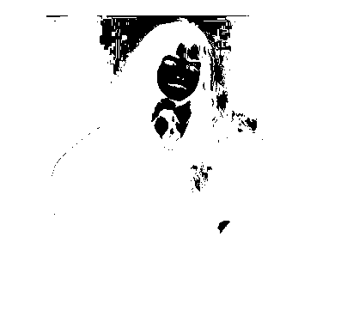
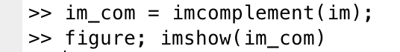
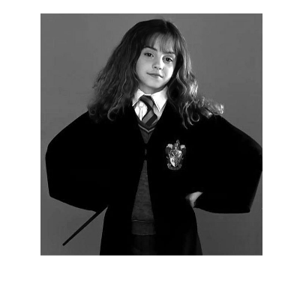
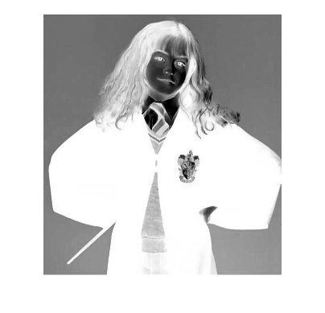
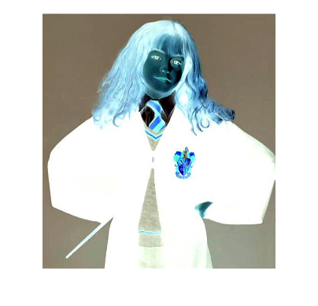
Taking the complement of a binary image
Binary
Grayscale
RGB
(Not as useful)

Slide 30
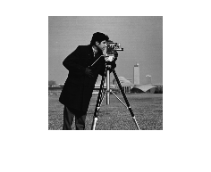
Image histograms
Image histograms are graphical representations of the pixel tone distributions in an image
Frequency
imhist Creates a 256 vector, where (i+1)’th element contains how often we see the grayscale intensity i
Intensity
How do we interpret this?

Slide 31
Image histograms: imhist
If the histogram has too many pixels on the left→image too dark
If the histogram has too many pixels on the right→image too light
If the histogram has too many pixels in the middle→image washed out
In biology, we want our images to be comparable. This means image intensities should all conform to the same distribution
Original
Too dark
Too light

Slide 32
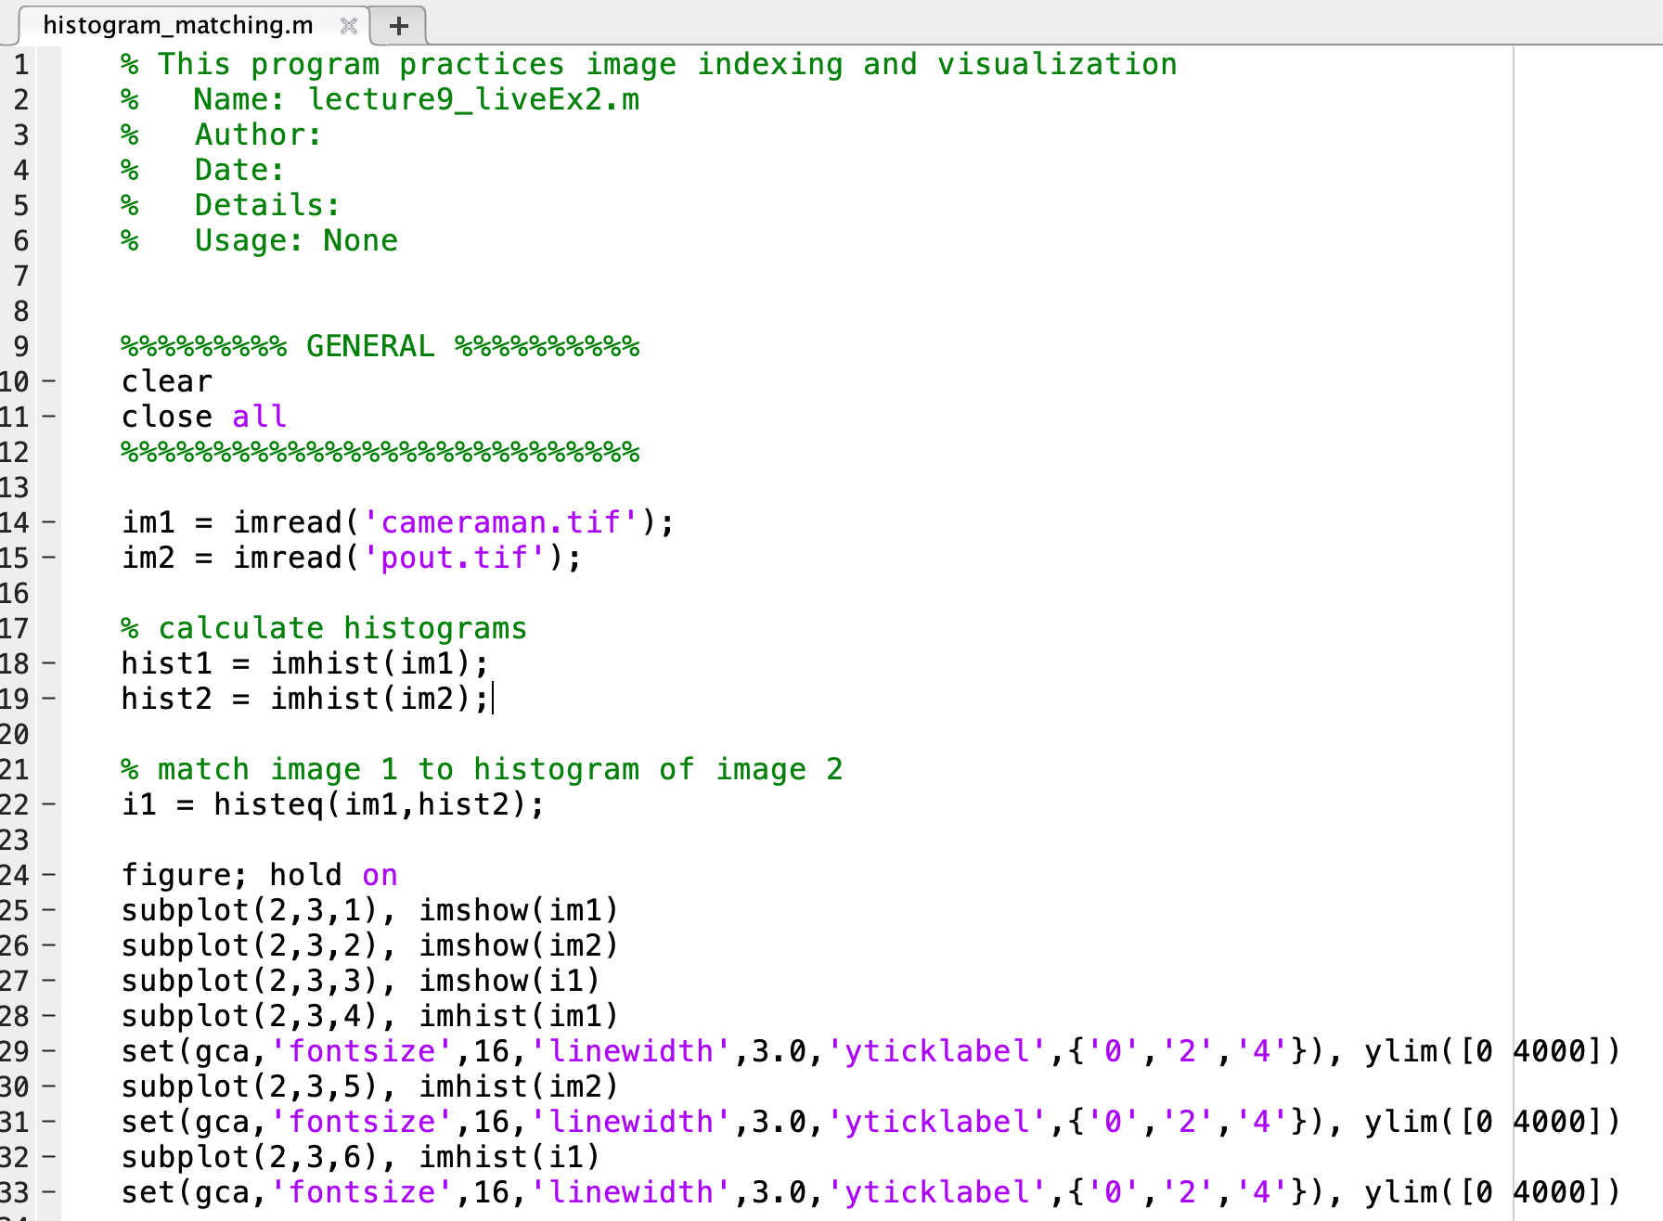
Histogram matching with histeq
Input 1: image to adjust
Input 2: histogram to match image1 to
X 10³ pixels
Intensity

Slide 33
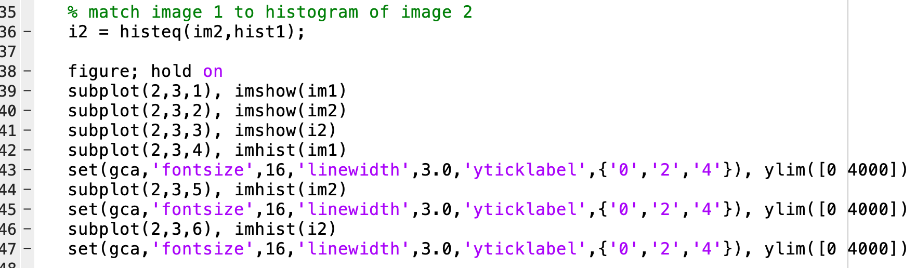
Histogram matching: other direction
X 10³ pixels
Intensity

Slide 34
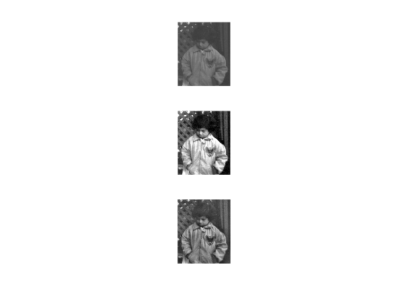
Histogram adjustments
Original
Good contrast → equal number of pixels at all intensities (what would that look like?)
Flat histogram
If a histogram looks bad, we can try and correct it by adjusting the image using a process called histogram equalization
MATLAB has functions for this :D
im = imread(‘pout.tif’)
Global histogram equalization (without matching!)
im1 = histeq(im)
Local histogram equalization
im2 = adapthisteq(im)

Slide 35
Write a function that takes in (1) a 1xn cell array consisting of n generic number of grayscale images, and (2) an image with which we wish to match the histogram of, and returns a new cell array of all n input images adjusted with modified histograms.
Demonstrate the function works by matching the histograms of flower.jpeg and Mona_Lisa.jpeg to the histogram of penguins.jpeg.
Plot both the original 3 images and the final 3 images on two separate figures with 1x3 subplots.
Group example 3: practice with image coordinates

Slide 36
Exam 2 information
Confirm MATLAB is functional on the computer you plan to sit at
Meant to be 1:30 length, but can take up to 3 hours
Material covers everything up until image analysis (image analysis not included):
Writing scripts and functions
Matrices/indexing
Control structure
Working with tables (import, filter, output, etc.)
Plotting (line plots, scatter plots, bar plots, errorbars, etc.)
Descriptive statistics (max, min, mean, variance, etc.)
Statistical tests (t-test, z-test, anova 1 and 2 way)
Linear regressions
Curve fitting
Format: 2 HW-style questions, and 1 trouble shooting question
You’ll be handing in 3 scripts

